Slide 1
CST2550 Coursework 1
Simon Sokolowski
M00948848

Slide 2
Introduction
Student Number: M00948848
Task Description:
This project is a Library Management System implemented as a console application in C++. It's designed to help manage library operations, such as tracking book issuances, returns, and calculating fines for late returns. The system features a simple text-based user interface that allows library staff to interact with the application through a series of menu options.

Slide 3
Key functionalities include:
Member Management: Add new members to the library system, allowing for the issuance and tracking of books to individuals.
Book Issuance: Issue books to members by entering member and book IDs. The system records the issuance and calculates the due date based on a predefined period.
Book Return: Manage the return of books. The system checks for overdue books and calculates fines based on the number of days late.
Fine Calculation: Automatically calculate fines for late returns, providing library staff with the ability to manage and enforce due dates.
Global Day System: A unique feature that simulates the passage of time within the application. It allows the library system to track current and due dates, adjusting the system's state accordingly.

Slide 4
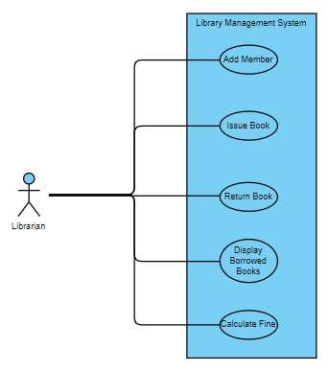
UML Use Case Diagram

Slide 5
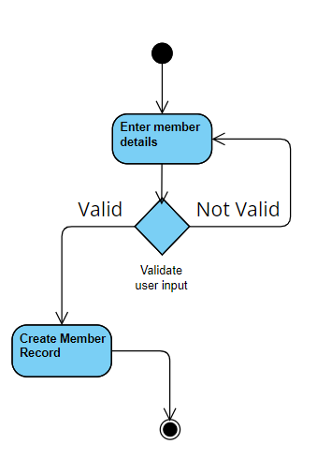
UML Activity Diagram – Add Member
This diagram illustrates the process of adding a new member to the library system. It includes activities such as entering member details and validating the entered data. If the data is valid, a new member record is created; if not, the user is prompted to re-enter the details.

Slide 6
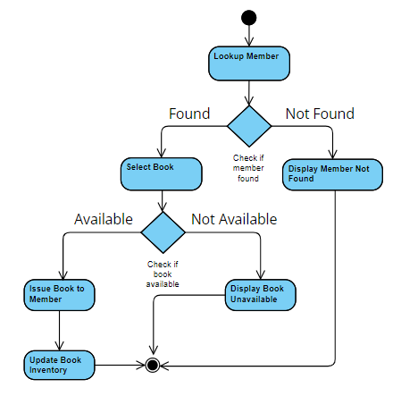
UML Activity Diagram – Issue Book
The diagram details the workflow of issuing a book to a library member. It starts with looking up the member and selecting the book. If the book is available, it is issued to the member, and the book inventory is updated; if not available, a message is displayed indicating the book is unavailable.

Slide 7
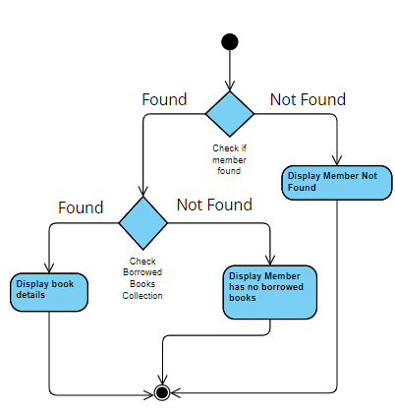
UML Activity Diagram – Display Borrowed Books
This diagram shows the process of displaying all books currently borrowed by a particular member. It includes verifying the member's existence in the system and then either listing all the borrowed books or indicating that no books are currently borrowed.

Slide 8
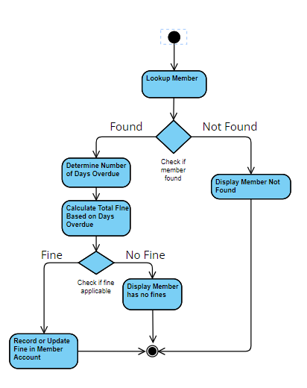
UML Activity Diagram – Issue Fine
This diagram would describe the process of calculating fines for a member based on overdue books. It involves finding the member, determining if a returned book is overdue and, if so, calculating the amount of fine based on the number of days it is late.

Slide 9
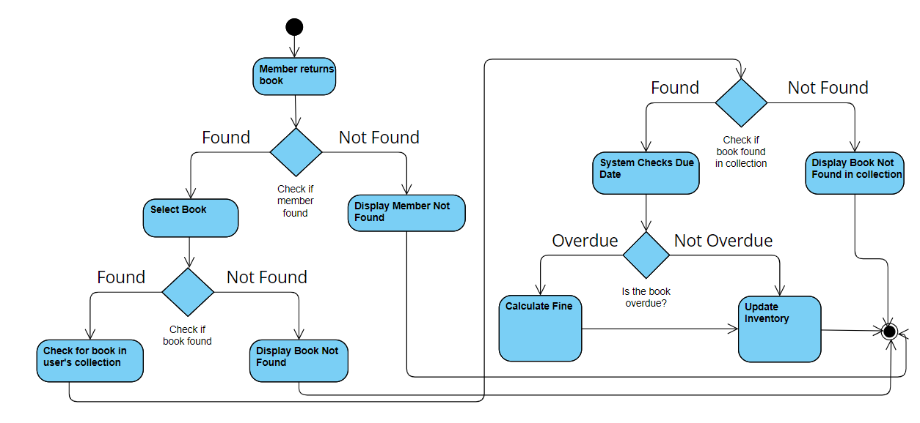
UML Activity Diagram – Return Book

Slide 10
UML Activity Diagram – Return Book
The diagram depicts the process of returning a book to the library. It involves finding the member and the book in question, checking if the book is in the member's possession, and then processing the return. If the book is overdue, a fine is calculated. Finally, the book inventory is updated to reflect the return.

Slide 11
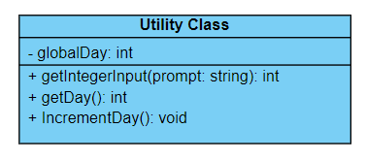
Use Case Diagram for added class

Slide 12
Implementation – Version Control
For this project, version control was implemented using Git and hosted on GitHub. I used Git to commit frequent changes to my codebase, which allowed me to maintain a detailed record of my project's evolution over time. Each commit served as a checkpoint to which I could easily revert, if necessary, thereby safeguarding against potential code regressions or unintended consequences of new code integrations. By pushing my commits to GitHub, I ensured that my project was backed up remotely, protecting against local data loss and complications.

Slide 13
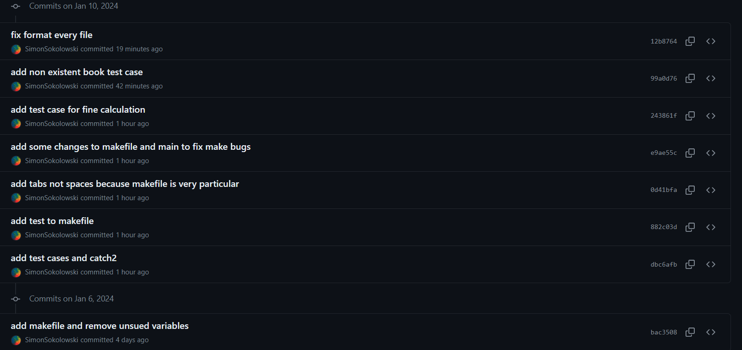
Note: Commits were added after the creation of the video and presentation to upload the video and presentation to repo.
Git Commit History – 52 total commits

Slide 14
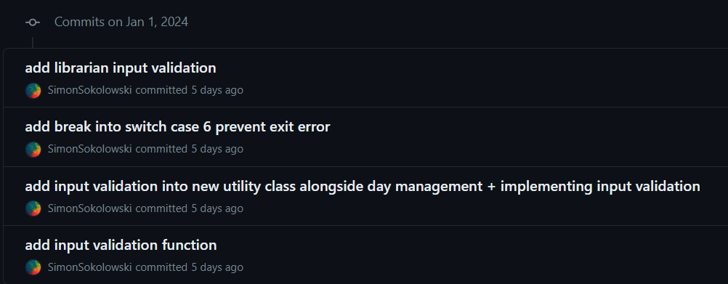

Slide 15
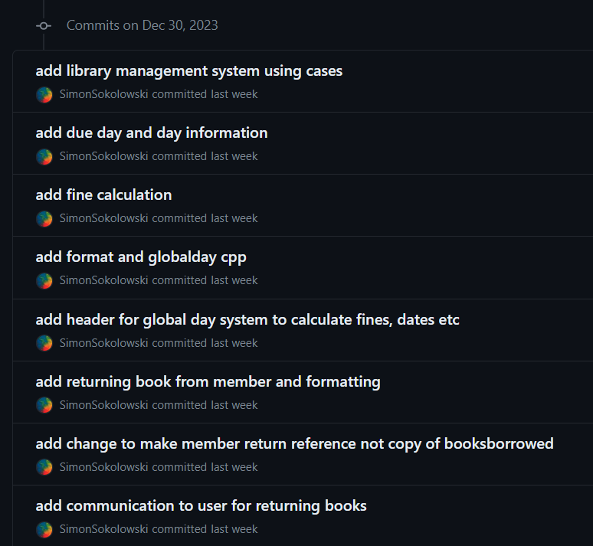

Slide 16
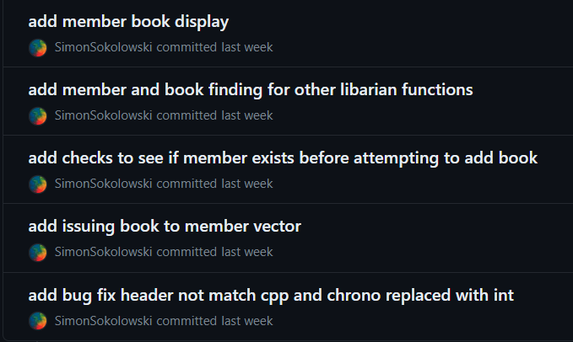

Slide 17
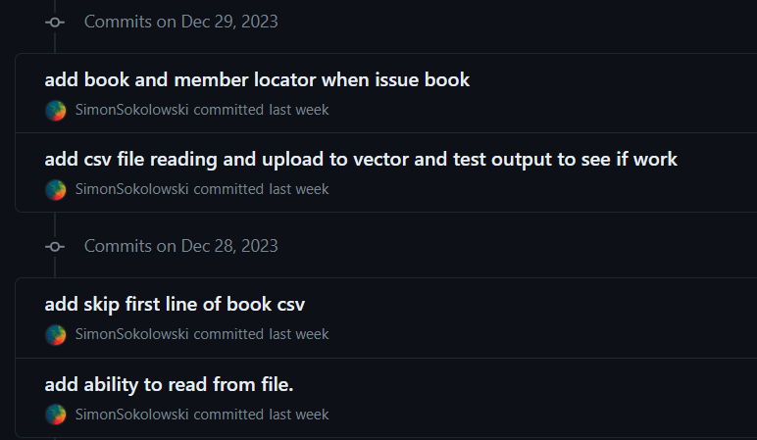

Slide 18
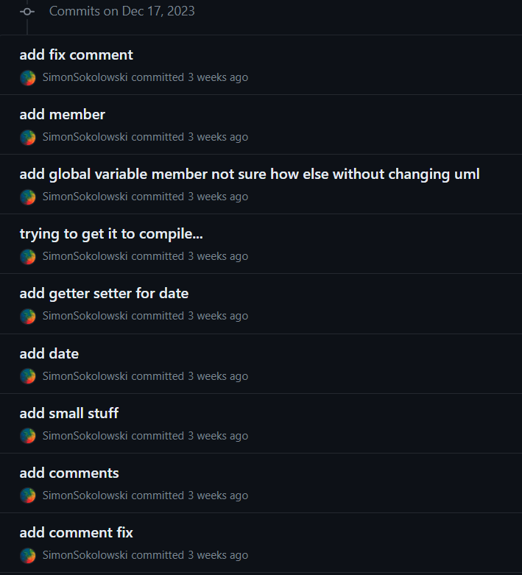

Slide 19
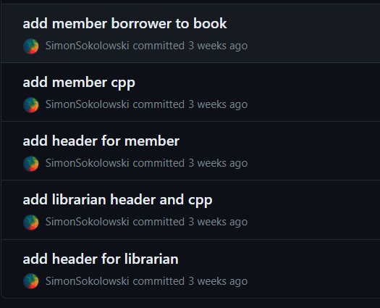

Slide 20
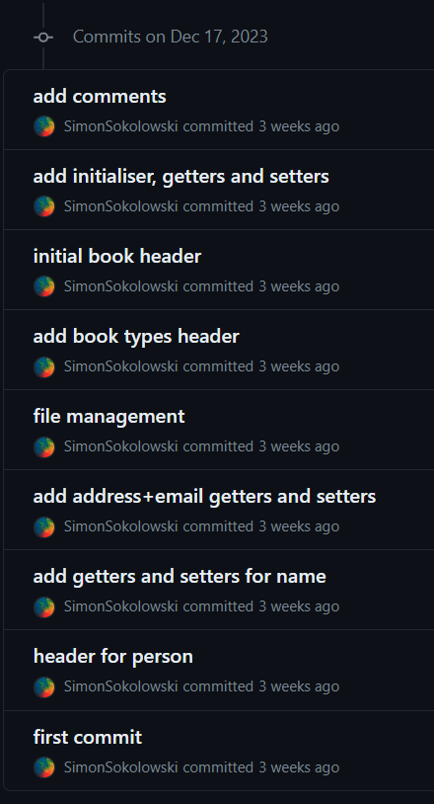

Slide 21
Code Implementation
To begin the implementation, I started by setting up the foundational classes - Member, Book, and Librarian - ensuring that each class's attributes and methods aligned with the responsibilities outlined in the use case diagrams.
I implemented the user interface in the main function, using switch cases to provide a text-based console menu to allow users to interact with the library system.

Slide 22
To create the working software application, I adopted a modular approach that included the creation of a utility class to encapsulate specific functionalities that were used across various parts of the system, such as the global day system which allowed simulation for the passage of time. The utility class also includes an input validation function to prevent non integers being input by the user.
I also included file handling to ensure a file can be open, can be found and is accessible. I have also handled the complex scenario of CSV parsing where commas within quotes are not treated as delimiters, done by temporarily replacing these commas with another character.

Slide 23
Makefile
The Makefile contained a set of directives for compiling the source code into an executable program. It specifies how to compile each .cpp file and how to link them together, automating the build process to be as efficient as possible. By running the make command, all source files are compiled, dependencies are resolved, and the final executable file is generated for me. It allowed me to ensure that only the necessary compilations were performed, saving time and avoiding potential human errors in the build process.
It also compiled an executable test program to run the Catch2 test cases.

Slide 24
How The Testing Approach Was Applied
The testing approach for the library management system involved using the Catch2 framework to create a series of unit tests. These tests were designed to validate the core functionalities of the Librarian class, particularly focusing on book issuing, returning, and fine calculation processes. The setup involved creating a controlled test environment where test members and books were programmatically added to the system, ensuring consistent testing conditions. This method allowed for the isolation of specific functions and the evaluation of their correctness without manual input. This comprehensive approach ensured that the key functionalities of the system were rigorously tested and validated.

Slide 25
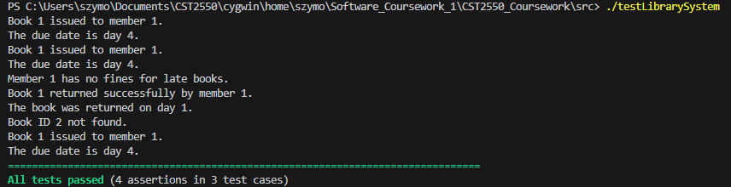
Librarian Test cases
Issuing a Book: Confirmed that books could be issued to members
Issuing an unavailable Book: Confirmed that trying to issue an unavailable book was properly handled.
Returning a Book: Ensured that books could be returned.
Calculate Fine: Confirmed that the correct fine is issued depending on how many days the book was late.

Slide 26
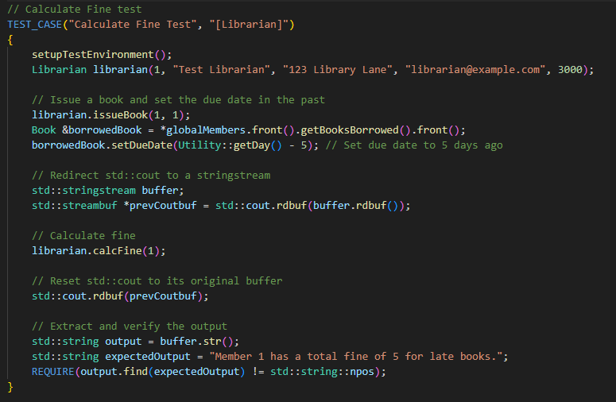
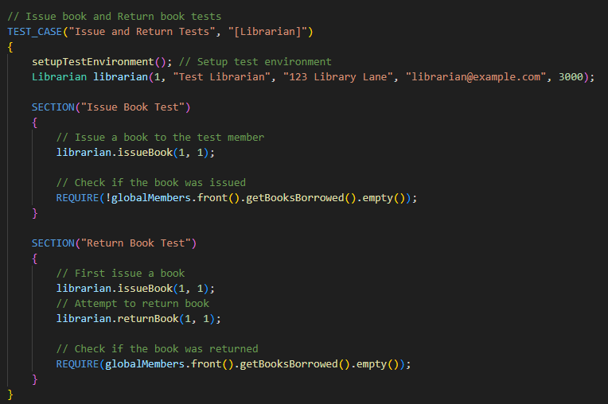
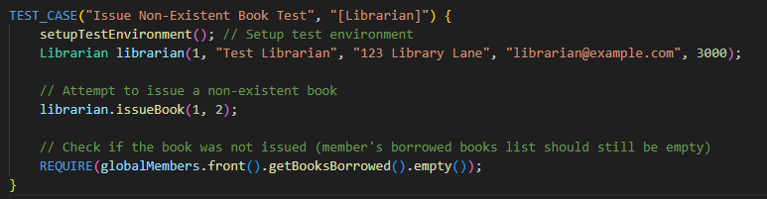
Test Cases for Librarian Class

Slide 27
Conclusion
The project involved developing a Library Management System in C++, utilizing object-oriented programming principles to create a robust and user-friendly application. Key functionalities included adding members, issuing and returning books, calculating fines, and managing a global day system to track time.

Slide 28
Limitations
Reflecting on the limitations of my code, particularly in the populateBooks() function, I realize that improvements could be made in handling file input, especially regarding the verification of file formats. Currently, the function assumes a well-structured CSV format without robust error checking. In the future, I would enhance this function to handle various edge cases more gracefully, such as incorrect formats, missing data, or improperly formatted entries.

Slide 29
Future Approach to Avoid Limitations
This could involve implementing more detailed checks for each line of the file, ensuring each piece of data conforms to expected types and formats, and providing meaningful error messages when discrepancies are found. Additionally, incorporating exception handling for scenarios like conversion errors (e.g., using std::stoi) would increase the robustness and user-friendliness of the application, preventing it from crashing or behaving unexpectedly with malformed input files.

